Slide 1


CS-2001 Data Structures Fall 2022 Introduction to Stack ADT
Mr. Muhammad Usman Joyia
National University of Computer and Emerging Sciences,
Faisalabad, Pakistan.

Slide 2
Roadmap
Previous Lecture
Variations of linked lists
Doubly linked lists
Circular Linked lists
Today
Introduction to Stack
Common applications
Array Based-Implementation
Linked-list Based Implementation

Slide 3
Stack
A structure consisting of homogeneous elements and:
Insertion and deletions takes place at one end called top
It is a commonly used abstract data type with two major operations, namely push and pop.
Other names
Last In First Out (LIFO) Structure
First In Last Out (FILO) Structure

Slide 4
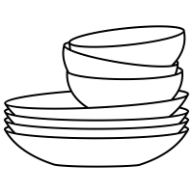

Real life scenarios…
Books on floor
Dishes on a shelf
In programming, consider doing X = (A+B) * (C+D)

Slide 5
Stack ADT Operations
Stack ADT emphasizes specific operations
Uses an explicit linear ordering (Random access is intentionally revoked)
Insertions and removals are performed individually.
Inserted objects are pushed onto the stack
Top of the stack is the most recent object pushed onto the stack
Push and pop operations changes the current top value of the stack

Slide 6
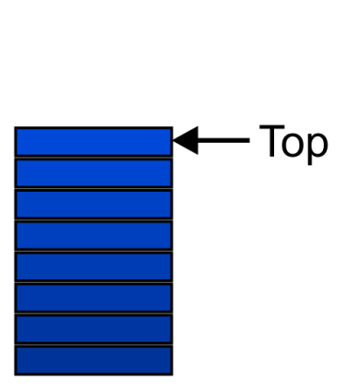
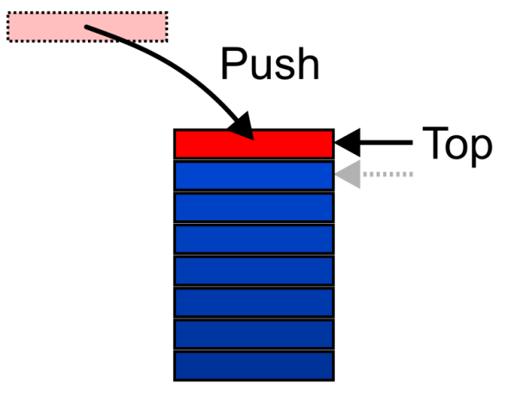
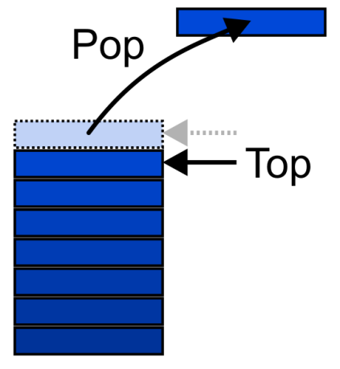
Stack ADT – Operations (1)
Graphically, the stack operations are viewed as follows:

Slide 7
Stack ADT – Operations (2)
CreateStack(S)
Make Stack S be an empty stack
Top(S)
Return the element at the top of stack S
Pop(S)
Remove the top element of the stack
Push(S,x)
Insert the element x at the top of the stack
Empty(S)
Return true if S is an empty stack and return false otherwise

Slide 8
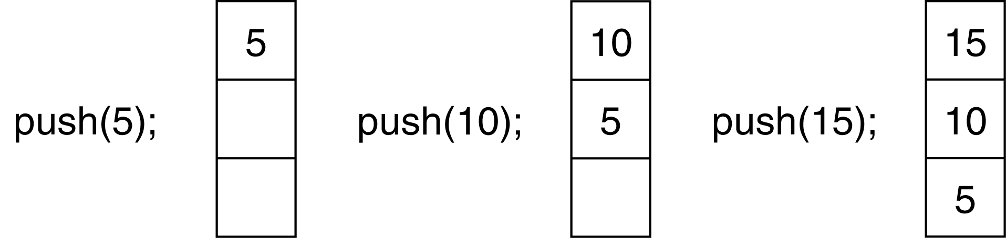
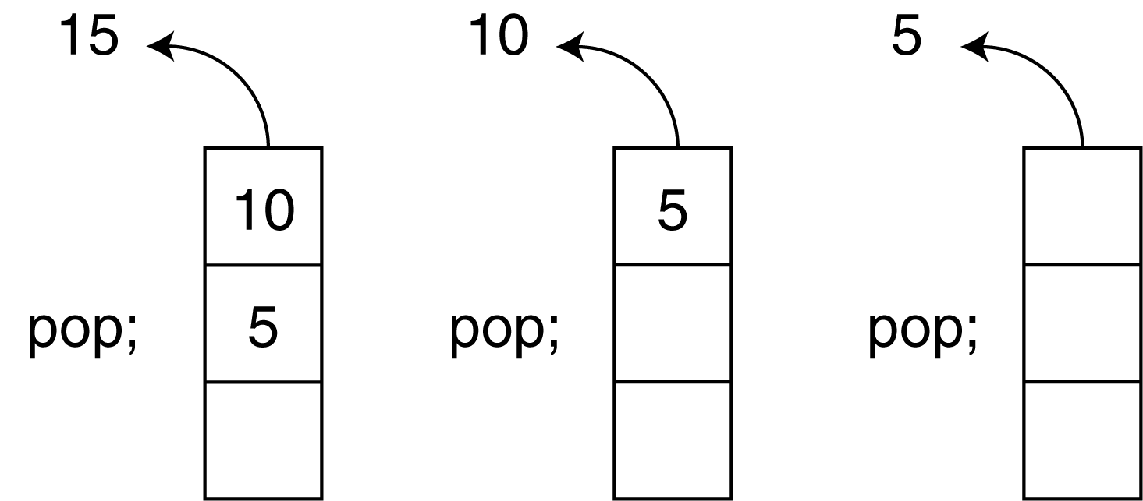
Push and Pop Operations of Stack

Slide 9
Applications (1)
Many applications
Parsing code
Matching parenthesis problem
Tracking function calls (Call stack)
Reversing a string
Infix to postfix Conversion
Backtracking in Depth-First-Search
The stack is a very simple data structure
Given any problem, if it is possible to use a stack, this significantly simplifies the solution

Slide 10
Applications (2)
Problem solving
Solving one problem may lead to subsequent subproblems
These subproblems may result in further subproblems
As subproblems are solved, focus shifts back to the initial problem
Notice that function calls behave similarly
A function is a collection of code which solves a problem

Slide 11
Use of Stack in Function Calls (1)
When a function begins execution an activation record is created to store the current execution environment for that function
Activation records all the necessary information about a function call, including
arguments passed by the caller function
Local variables
Content of the registers
Return address to the caller function
Address of instruction following the function call

Slide 12
Use of Stack in Function Calls (2)
Each invocation of a function has its own activation record
Recursive/Multiple calls to the functions require several activation records to exist simultaneously
A function returns only after all functions it calls have returned Last In First Out (LIFO) behavior
A program/OS keeps track of all the functions that have been called using run-time stack or call stack

Slide 13
Runtime Stack Example (1)
void main(){
int a=3;
f1(a); // statement A
cout << endl;
}
void f1(int x){
cout << f2(x+1); // statement B
}
int f2(int p){
int q=f3(p/2); // statement C
return 2*q;
}
int f3(int n){
return n*n+1;
}

Slide 14
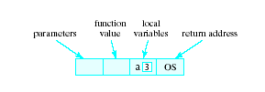
Runtime Stack
When a function is called …
Copy of activation record pushed onto run-time stack
Arguments copied into parameter spaces
Control is transferred to starting address of body of function
Return value
Function value
Local variables
Parameters
Return address
OS denotes that when execution of main() is completed, it returns to the operating system

Slide 15
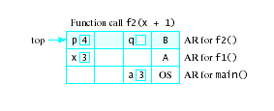
Runtime Stack Example (2)
void main(){
int a=3;
f1(a); // statement A
cout << endl;
}
void f1(int x){
cout << f2(x+1); // statement B
}
int f2(int p){
int q=f3(p/2); // statement C
return 2*q;
}
int f3(int n){
return n*n+1;
}

Slide 16
Static and Dynamic Stacks
Two possible implementations of stack data structure
Static, i.e., fixed size implementation using arrays
Dynamic implementation using linked lists

Slide 17
Array-based Implementation

Slide 18
Array Implementation – First Solution (1)
Elements are stored in contiguous cells of an array
New elements can be inserted to the top of the list
top
last-pushed Element
Second-last Element
List
1st pushed Element
Empty
maxlength

Slide 19
Array Implementation – First Solution (2)
Problem
Every PUSH and POP requires moving the entire array up and down
Fixed size
1
2
3
2
1
2
1
1
…

Slide 20
Array Implementation – Tweaked Solution (2)
Idea
Anchor the bottom of the stack at the start of the array
Let the stack grow towards the last of the array
Top indicates the current position of the recently inserted stack element
1st pushed Element
1
2
2nd -pushed Element
List
…
top
Last-pushed Element
Empty
maxlength

Slide 21
Array Implementation – Code (1)
class IntStack { private: int *stackArray; int stackSize; int top; public: IntStack(int);
~IntStack( ); bool push(int); bool pop(int &); bool isFull(); bool isEmpty(); };

Slide 22
Array Implementation – Code (2)
Constructor
IntStack::IntStack(int size) //constructor { stackArray = new int[size]; stackSize = size; top = -1; }
Destructor
IntStack::~IntStack(void) //destructor
{ delete [] stackArray;
}

Slide 23
Array Implementation – Code (3)
isFull function
bool IntStack::isFull(void) { if (top == stackSize - 1) return true; else return false; // return (top == stackSize-1); }
isEmpty function
bool IntStack::isEmpty(void)
{
return (top == -1); }

Slide 24
Array Implementation – Code (4)
push function inserts the argument num onto the stack
bool IntStack::push(int num) { if (isFull())
{
cout << "The stack is full.\n";
return false;
}
top++;
stackArray[top] = num;
return true;
}

Slide 25
Array Implementation – Code (5)
Pop function removes the value from top of the stack and returns it as a reference
bool IntStack::pop(int &num)
{
if (isEmpty())
{
cout << "The stack is empty.\n";
return false;
}
num = stackArray[top];
top--;
return true;
}

Slide 26
Using Stack (1)
int main() { IntStack stack(4);
}
stackArray
[0]
top
-1
[1]
stackSize
4
[2]
[3]

Slide 27
Using Stack (2)
int main() { IntStack stack(4); int catchVar;
cout << "Pushing Integers\n"; stack.push(5); stack.push(10); stack.push(15); stack.push(20);
}
stackArray
5
[0]
top
3
10
[1]
stackSize
4
15
[2]
20
[3]

Slide 28
Using Stack (3)
int main() { IntStack stack(4); int catchVar;
cout << "Pushing Integers\n"; stack.push(5); stack.push(10); stack.push(15); stack.push(20);
cout << "Popping...\n"; stack.pop(catchVar); cout << catchVar << endl;
}
num
20
stackArray
5
[0]
top
2
10
[1]
stackSize
4
15
[2]
[3]

Slide 29
Using Stack (4)
int main() { IntStack stack(4); int catchVar;
cout << "Pushing Integers\n"; stack.push(5); stack.push(10); stack.push(15); stack.push(20);
cout << "Popping...\n"; stack.pop(catchVar); cout << catchVar << endl; stack.pop(catchVar); cout << catchVar << endl; stack.pop(catchVar); cout << catchVar << endl; stack.pop(catchVar); cout << catchVar << endl;
return 0; }
Output:
Pushing Integers
Popping…
20
15
10
5

Slide 30
Linkedlist based Implementation

Slide 31
Pointer-based Implementation of Stacks
Stack can expand or shrink with each push or pop operation
Push and pop operate only on the head node, i.e., the first node of the list
.
Top
x
y
z

Slide 32
Pointer Implementation – Code (1)
class node
{ public:
int data; node *next;
};
class Stack
{
node *top;
public:
Stack();
~Stack();
void Push(int newelement);
bool Pop(int &);
bool IsEmpty();
void makeNull();
};

Slide 33
Pointer Implementation – Code (2)
Constructor
Stack::Stack() { top = NULL; }
IsEmpty function returns true if the stack is empty
bool Stack::IsEmpty()
{
return (top == NULL);
}

Slide 34
Pointer Implementation – Code (3)
Push function inserts a node at the top/head of the stack
void Stack::Push(int newelement)
{
node *newptr = new node;
newptr->data=newelement;
newptr->next=top;
top=newptr;
}

Slide 35
Pointer Implementation – Code (4)
Pop function deletes the node from the top of the stack and returns its data by reference
bool Stack::Pop(int& returnvalue)
{
if (IsEmpty())
{
cout<<“underflow error”;
return false;
}
node* tempptr = top;
returnvalue = top->data;
top = top->next;
delete tempptr;
return true;
}

Slide 36
Pointer Implementation – Code (5)
Destructor
Stack::~Stack() { makeNull(); }
makeNull() resets top pointer to NULL
void Stack::makeNull() {
int x; while( Pop(x) ); }

Slide 37
Any Question So Far?

